Slide 1


HEART DIESEASE PREDICTION
Project Presentation By
Nikhilraj Rindhe
Gourang Baviskar
Akshay Shirsath
Minal Patil
Under Guidance of
Mr.Kushal Sharma

Slide 2

HEART DIESEASE

Slide 3
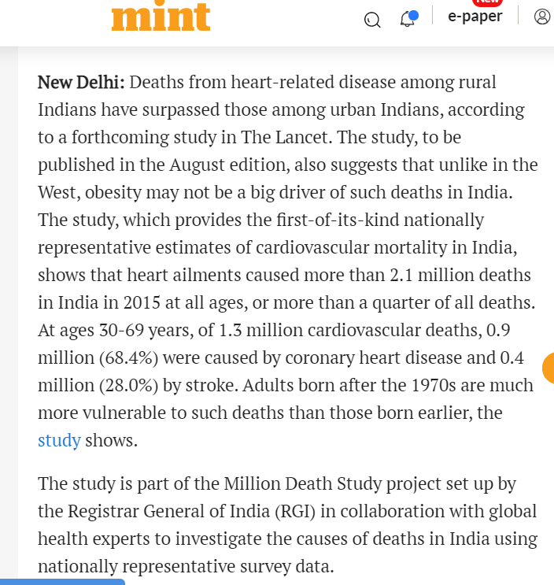
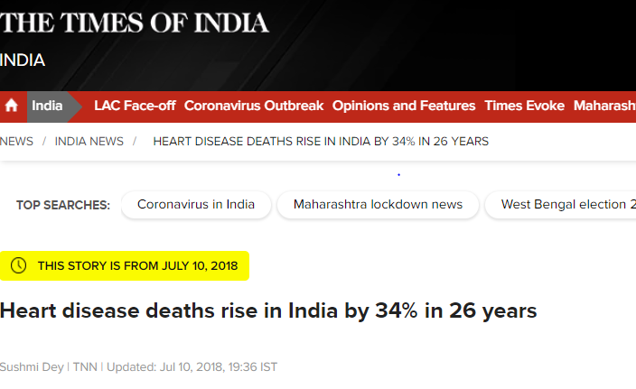
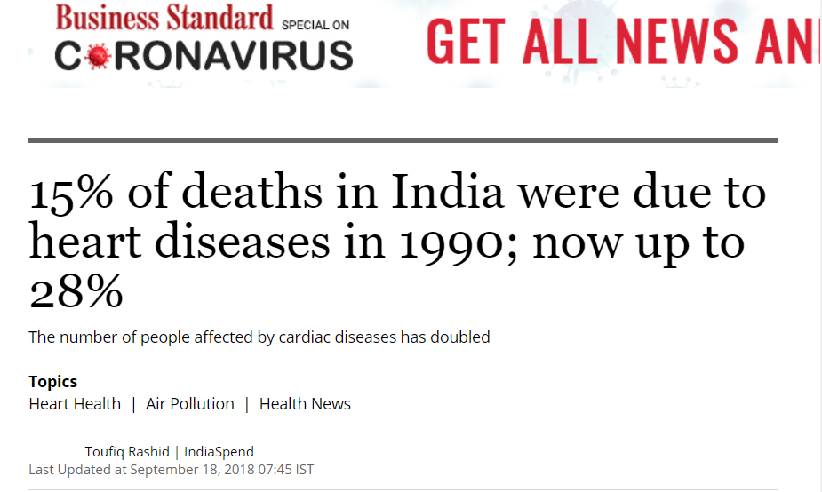

Slide 4

PROBLEM STATEMENT
To predict the possibility of having heart disease
non-invasively?

Slide 5

EXISTING SCENARIOS

Slide 6

PROPOSED SOLUTION

Slide 7


Slide 8


CHALLENGES
Improving quality of analytical data
Using data to improve experiences

Slide 9

BENIFITS
1.Heart Disease Pre-Diagnosis Tool
2. Smart Health Record
3. Generic Diseases Prediction Models

Slide 10


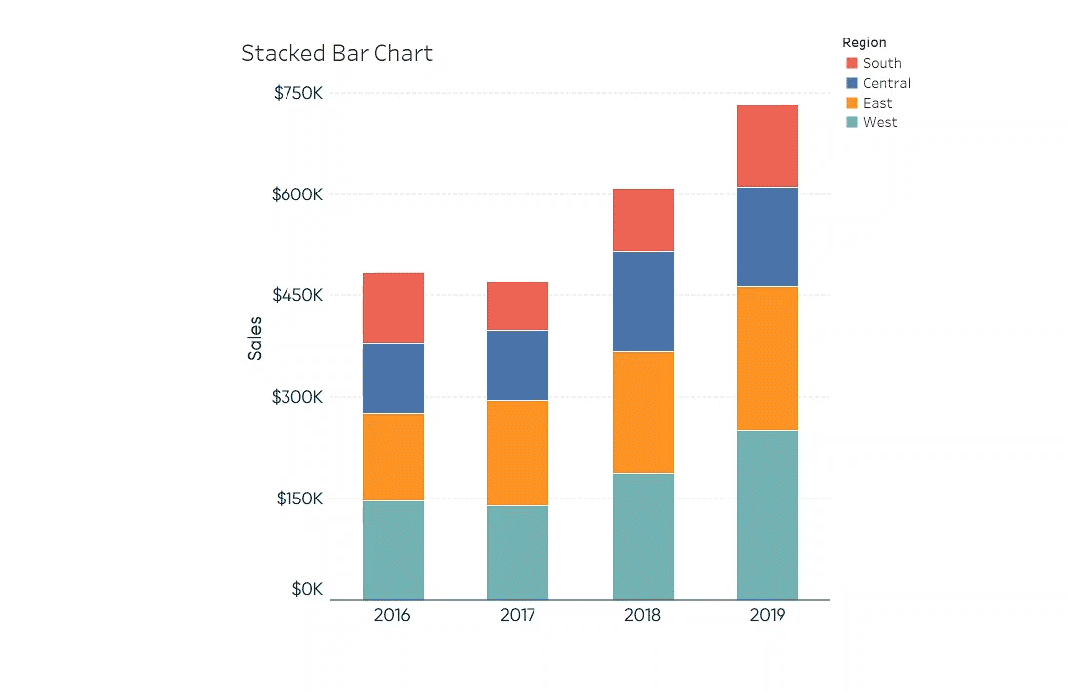

ARCHITECTURE DIAGRAM
Data Analysis(Machine Learning)
Data Sources
(Patient reports)
Data Warehouse
Reporting
Tableau/Power BI

